Slide 1



Youth Offer Consortium Consultation: Aggie Keightley – Smith; Early Help Manager – Youth & Community Service
Youth Offer Consortium Consultation
Aggie Keightley-Smith
Early Help Manager – Youth & Community Services

Slide 2
Background:
The Youth Offer Survey ‘Your Future, Your Say’ was designed by the consortium to gather feedback from young people about the youth provision available across Redcar & Cleveland.
Aim was to use this information to hopefully address any areas of need and build on those areas that are working well.
321 young people across the borough took part in this consultation aged between 8 and 19, (25 SEND).
Young people’s involvement was facilitated by Youth Offer Consortium, schools and wider community.
Young people were asked 10 questions about what they want from youth groups including, affordability, travel, how they find out about groups, what barriers there are and if the services already out there suit their needs.

Slide 3












Youth Offer Consortium Members
Consists of services delivering open access youth provisions (non-uniform, none profit services) who support Redcar & Cleveland’s young people.

Slide 4
Key areas: Most important service to provide?
Young people said: 162 felt having the opportunity to access youth clubs/services you can drop into, to chill with friends was the most important service to them. Followed by 117 young people stating services delivering sports activities and 112 stating being able to be with other young people with the same interests. Young people each selected a number of opportunities, demonstrating that offering a wide range of choices is important to cater to their differing likes and needs.

Slide 5
Key areas: Most important when attending?
Young people said: When attending youth activities 193 said what was most important was to have fun and 152 stated being able to socialise safely with friends. Young people want to have the opportunity to attend a wide range of activities with their peers, to have fun and they want to feel safe.

Slide 6
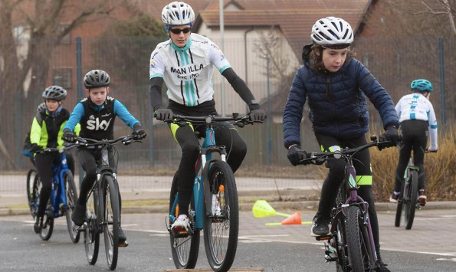


Key areas: Travel
Young people said: 75% said currently it takes up to 10 minutes to get to their youth activity with equal amounts walking and getting lifts from family. 90% said they would walk up to 20 minutes to get to an activity they are interested in. The results show that young people want to access services in their community, within walking distance or a short car journey for their parents/carers.
What we currently offer across the Consortium:
30 varied youth provisions are delivered in local settings across 13 towns in Redcar & Cleveland:
Redcar, Dormanstown, Marske, Saltburn, Skelton, Skinningrove, Loftus, Lingdale, Liverton Mines, Guisborough, Eston, Grangetown and Southbank. These sessions are delivered in youth centres, community centres, purpose built venues, schools, sporting spaces inside and out and through detached outreach.

Slide 7


Key areas: How do you find out about youth activities?
Young people said: 61% said they find out about youth activities through friends, 15% through schools and 12% through parents/carers. Only a small percentage find information through websites or on social media.
What we currently do:
Promote activities to young people within sessions
Promote activities/services in the community
Promote activities/services in schools
Promote activities on social media
Some sessions are targeted and young people are referred in from other professionals

Slide 8


Key areas: How much would you pay?
Young people said: 59% think it is reasonable to pay up £1 for a youth session, 12% think it should be free, 12% said they would pay between £1 - £2 and 11% would pay £2 - £3.
What do we currently offer:
1:1 support (a referred service free to young people)
Youth session average charge is between 50p - £1 to attend
Services will offer sessions free to those who cannot afford to pay
Holiday programmes may be free (funding dependant) or charge more depending on the activities
Some services have funding and offer all their provision free to targeted young people

Slide 9
‘You said, we will’
The Youth Offer Consortium partners all agree that the key areas of importance to young people are aligned with the priorities of the service providers in Redcar and Cleveland.
All parties agreed more opportunities/youth sessions would benefit young people
The group will look at how to address geographical gaps in provision
We will explore joint working and sharing spaces available
We will share information about our programmes to give young people more opportunities to find out about activities available to them
We will continue to ensure all sessions are in welcoming and safe places
We will explore a kite mark system to show young people and parents/carers that the services available follow a safe practice code
We will explore a joint website showcasing all the youth services on offer in Redcar & Cleveland in one place, allowing easy access for young people and their parents/carers

Slide 10
‘The power of youth work’
‘The Power of Youth Work’

